Slide 1
Rich Internet Application

Slide 2
Introduction
Desktop is a very powerful s/w experience when talked about look & feel.
To a user, it is easy to handle and work with any software that behaves in a manner similar to a users desktop.
New ways are being adopted to develop interfaces that provide users with better powerful experiences.
Applications developed to provide exciting rich interactivity features in software programs are known as Rich Internet Applications (RIA).
Notes:
How presentation will benefit audience: Adult learners are more interested in a subject if they know how or why it is important to them.
Presenter’s level of expertise in the subject: Briefly state your credentials in this area, or explain why participants should listen to you.

Slide 3
Introduction
RIAs are developed as web applications behaving like desktop application in their look & feel.
RIA can perform computation on both the client side and sever side.
It is developed using various technologies that includes Java, Silverlight, JavaFX, Adobe Flash & Flex, AJAX, OpenLaszlo
Notes:
How presentation will benefit audience: Adult learners are more interested in a subject if they know how or why it is important to them.
Presenter’s level of expertise in the subject: Briefly state your credentials in this area, or explain why participants should listen to you.

Slide 4
Characteristics of RIA
Enhanced Accessibility
Direct Interaction
Improved features
Partial update of webpages.
Better feedback to users.
Collaborative Web Application Access
Consistency of look & feel
Offline use of the application
Impact on performance
Notes:
How presentation will benefit audience: Adult learners are more interested in a subject if they know how or why it is important to them.
Presenter’s level of expertise in the subject: Briefly state your credentials in this area, or explain why participants should listen to you.

Slide 5
Introduction to AJAX
Asynchronous JavaScript and XML

Slide 6
Asynchronous JavaScript and XML
AJAX is an acronym for Asynchronous JavaScript and XML.
It is a group of inter-related technologies like JavaScript, DOM, XML, HTML/XHTML, CSS, XMLHttpRequest etc.
AJAX allows to send and receive data asynchronously without reloading the web page.
AJAX allows to send only important information to the server not the entire page.
So only valuable data from the client side is routed to the server side.
It makes application interactive and faster.
There are too many web applications running on the web that are using ajax technology
gmail, facebook, twitter, google map, youtube etc.
Notes:
How presentation will benefit audience: Adult learners are more interested in a subject if they know how or why it is important to them.
Presenter’s level of expertise in the subject: Briefly state your credentials in this area, or explain why participants should listen to you.

Slide 7
Asynchronous JavaScript and XML
AJAX
not a programming language.
imply a development technique for creating interactive web applications.
JavaScript
Client side scripting language.
It is executed on the client side by the web browsers that support JavaScript.
JavaScript code only works in browsers that have JavaScript enabled.
XML
Acronym for Extensible Markup Language.
It is used to encode messages in both human and machine readable formats.
It’s like HTML but allows you to create your custom tags
Notes:
How presentation will benefit audience: Adult learners are more interested in a subject if they know how or why it is important to them.
Presenter’s level of expertise in the subject: Briefly state your credentials in this area, or explain why participants should listen to you.

Slide 8
Asynchronous JavaScript and XML
AJAX uses an XMLHttpRequest object to send data to a web server
XML is commonly used as the format for receiving server data, although any format including JSON, plain text can be used.
Notes:
How presentation will benefit audience: Adult learners are more interested in a subject if they know how or why it is important to them.
Presenter’s level of expertise in the subject: Briefly state your credentials in this area, or explain why participants should listen to you.

Slide 9
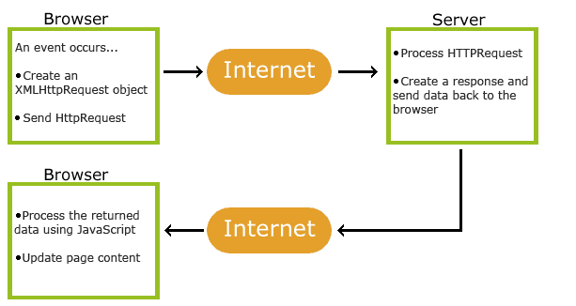
How it Works?
An event occurs in a web page (the page is loaded, a button is clicked)
An XMLHttpRequest object is created by JavaScript
The XMLHttpRequest object sends a request to a web server
The server processes the request
The server sends a response back to the web page
The response is read by JavaScript
Proper action (like page update) is performed by JavaScript
Notes:
How presentation will benefit audience: Adult learners are more interested in a subject if they know how or why it is important to them.
Presenter’s level of expertise in the subject: Briefly state your credentials in this area, or explain why participants should listen to you.

Slide 10
XMLHttpRequest Object
The keystone of AJAX is the XMLHttpRequest object.
All modern browsers support the XMLHttpRequest object.
The XMLHttpRequest object can be used to exchange data with a server behind the scenes.
This means that it is possible to update parts of a web page, without reloading the whole page.
Notes:
How presentation will benefit audience: Adult learners are more interested in a subject if they know how or why it is important to them.
Presenter’s level of expertise in the subject: Briefly state your credentials in this area, or explain why participants should listen to you.

Slide 11
XMLHttpRequest Object
An object of XMLHttpRequest is used for asynchronous communication between client and server.
It performs following operations:
Sends data from the client in the background
Receives the data from the server
Updates the webpage without reloading it.
Notes:
How presentation will benefit audience: Adult learners are more interested in a subject if they know how or why it is important to them.
Presenter’s level of expertise in the subject: Briefly state your credentials in this area, or explain why participants should listen to you.

Slide 12
XMLHttpRequest Object
Create an XMLHttpRequest Object
All modern browsers (Chrome, Firefox, IE7+, Edge, Safari Opera) have a built-in XMLHttpRequest object.
Syntax for creating an XMLHttpRequest object:
variable = new XMLHttpRequest();
Eg: var xhttp = new XMLHttpRequest();
Notes:
How presentation will benefit audience: Adult learners are more interested in a subject if they know how or why it is important to them.
Presenter’s level of expertise in the subject: Briefly state your credentials in this area, or explain why participants should listen to you.

Slide 13
Methods of XMLHttpRequest Object
Method Description
new XMLHttpRequest() Creates a new XMLHttpRequest object
abort() Cancels the current request
getAllResponseHeaders() Returns header information
getResponseHeader() Returns specific header information
open(method, url, async, user, psw) Specifies the request
method: the request type GET or POST
url: the file location
async: true (asynchronous) or false (synchronous)
user: optional user name
psw: optional password
Notes:
How presentation will benefit audience: Adult learners are more interested in a subject if they know how or why it is important to them.
Presenter’s level of expertise in the subject: Briefly state your credentials in this area, or explain why participants should listen to you.

Slide 14
Methods of XMLHttpRequest Object
Method Description
send() Sends the request to the server
Used for GET requests
send(string) Sends the request to the server.
Used for POST requests
setRequestHeader() Adds a label/value pair to the header to be sent
Notes:
How presentation will benefit audience: Adult learners are more interested in a subject if they know how or why it is important to them.
Presenter’s level of expertise in the subject: Briefly state your credentials in this area, or explain why participants should listen to you.

Slide 15
Properties of XMLHttpRequest Object
Property Description
onload Defines a function to be called when the request is recived (loaded)
onreadystatechange Defines a function to be called when the readyState property changes
readyState Holds the status of the XMLHttpRequest.
0: request not initialized
1: server connection established
2: request received
3: processing request
4: request finished and response is ready
Notes:
How presentation will benefit audience: Adult learners are more interested in a subject if they know how or why it is important to them.
Presenter’s level of expertise in the subject: Briefly state your credentials in this area, or explain why participants should listen to you.

Slide 16
Properties of XMLHttpRequest Object
Property Description
responseText Returns the response data as a string
responseXML Returns the response data as XML data
status Returns the status-number of a request
200: "OK"
403: "Forbidden"
404: "Not Found"
statusText Returns the status-text (e.g. "OK" or "Not Found")
Notes:
How presentation will benefit audience: Adult learners are more interested in a subject if they know how or why it is important to them.
Presenter’s level of expertise in the subject: Briefly state your credentials in this area, or explain why participants should listen to you.

Slide 17
The onload property Example
<!DOCTYPE html>
<html>
<body>
<div id="demo">
<h2>The XMLHttpRequest Object</h2>
<button type="button" onclick="loadDoc()">Change Content</button>
</div>
<script>
function loadDoc() {
const xhttp = new XMLHttpRequest();
xhttp.onload = function() {
document.getElementById("demo").innerHTML =
this.responseText;
}
xhttp.open("GET", "ajax_info.txt");
xhttp.send();
}
</script>
</body>
</html>
The XMLHttpRequest object is used to exchange data with a server.
To send a request to a server, use the open() and send() methods of the XMLHttpRequest object:
xhttp.open("GET", "ajax_info.txt", true);
xhttp.send();
For security reasons, modern browsers do not allow access across domains.
This means that both the web page and the XML file it tries to load, must be located on the same server.
Notes:
How presentation will benefit audience: Adult learners are more interested in a subject if they know how or why it is important to them.
Presenter’s level of expertise in the subject: Briefly state your credentials in this area, or explain why participants should listen to you.

Slide 18
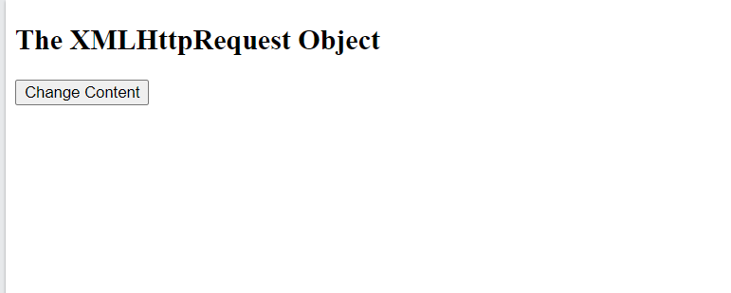
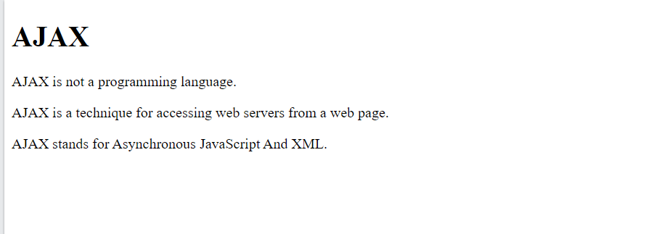
The onload property Example
<!DOCTYPE html>
<html>
<body>
<div id="demo">
<h2>The XMLHttpRequest Object</h2>
<button type="button" onclick="loadDoc()">Change Content</button>
</div>
<script>
function loadDoc() {
const xhttp = new XMLHttpRequest();
xhttp.onload = function() {
document.getElementById("demo").innerHTML =
this.responseText;
}
xhttp.open("GET", "ajax_info.txt");
xhttp.send();
}
</script>
</body>
</html>
Notes:
How presentation will benefit audience: Adult learners are more interested in a subject if they know how or why it is important to them.
Presenter’s level of expertise in the subject: Briefly state your credentials in this area, or explain why participants should listen to you.

Slide 19
GET or POST method?
GET is simpler and faster than POST, and can be used in most cases.
Use POST requests when:
A cached file is not an option (update a file or database on the server).
Sending a large amount of data to the server (POST has no size limitations).
Sending user input (which can contain unknown characters), POST is more robust and secure than GET.
Notes:
How presentation will benefit audience: Adult learners are more interested in a subject if they know how or why it is important to them.
Presenter’s level of expertise in the subject: Briefly state your credentials in this area, or explain why participants should listen to you.

Slide 20
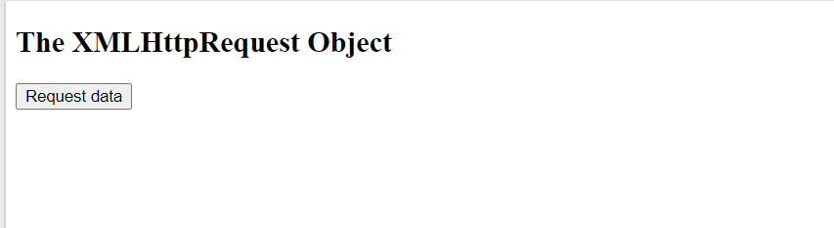
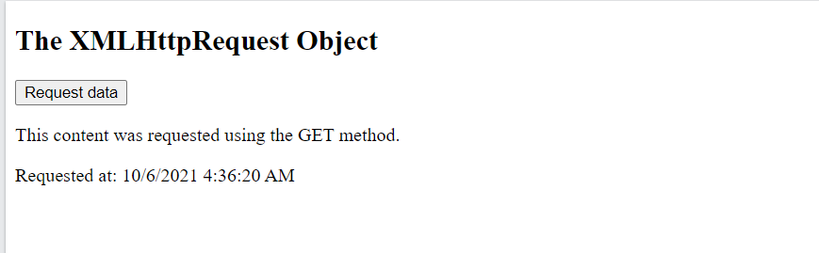
GET method Example
<!DOCTYPE html>
<html>
<body>
<h2>The XMLHttpRequest Object</h2>
<button type="button" onclick="loadDoc()">Request data</button>
<p id="demo"></p>
<script>
function loadDoc() {
const xhttp = new XMLHttpRequest();
xhttp.onload = function() {
document.getElementById("demo").innerHTML = this.responseText;
}
xhttp.open("GET", "demo_get.asp");
xhttp.send();
}
</script>
</body>
</html>
Notes:
How presentation will benefit audience: Adult learners are more interested in a subject if they know how or why it is important to them.
Presenter’s level of expertise in the subject: Briefly state your credentials in this area, or explain why participants should listen to you.

Slide 21
GET method Example (With math.random)
<!DOCTYPE html>
<html>
<body>
<h2>The XMLHttpRequest Object</h2>
<button type="button" onclick="loadDoc()">Request data</button>
<p id="demo"></p>
<script>
function loadDoc() {
const xhttp = new XMLHttpRequest();
xhttp.onload = function() {
document.getElementById("demo").innerHTML = this.responseText;
}
xhttp.open("GET", "demo_get.asp?t=" + Math.random());
xhttp.send();
}
</script>
</body>
</html>
Notes:
How presentation will benefit audience: Adult learners are more interested in a subject if they know how or why it is important to them.
Presenter’s level of expertise in the subject: Briefly state your credentials in this area, or explain why participants should listen to you.

Slide 22
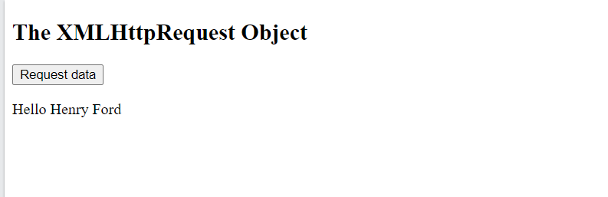
GET method Example (Adding information to URL)
<!DOCTYPE html>
<html>
<body>
<h2>The XMLHttpRequest Object</h2>
<button type="button" onclick="loadDoc()">Request data</button>
<p id="demo"></p>
<script>
function loadDoc() {
const xhttp = new XMLHttpRequest();
xhttp.onload = function() {
document.getElementById("demo").innerHTML = this.responseText;
}
xhttp.open("GET", "demo_get2.asp?fname=Henry&lname=Ford");
xhttp.send();
}
</script>
</body>
</html>
Notes:
How presentation will benefit audience: Adult learners are more interested in a subject if they know how or why it is important to them.
Presenter’s level of expertise in the subject: Briefly state your credentials in this area, or explain why participants should listen to you.

Slide 23
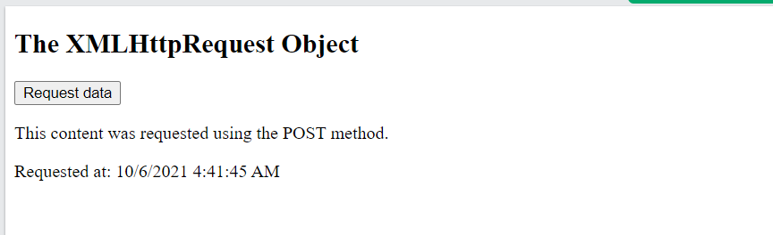
POST method Example
<!DOCTYPE html>
<html>
<body>
<h2>The XMLHttpRequest Object</h2>
<button type="button" onclick="loadDoc()">Request data</button>
<p id="demo"></p>
<script>
function loadDoc() {
const xhttp = new XMLHttpRequest();
xhttp.onload = function() {
document.getElementById("demo").innerHTML = this.responseText;
}
xhttp.open("POST", "demo_post.asp");
xhttp.send();
}
</script>
</body>
</html>
Notes:
How presentation will benefit audience: Adult learners are more interested in a subject if they know how or why it is important to them.
Presenter’s level of expertise in the subject: Briefly state your credentials in this area, or explain why participants should listen to you.

Slide 24
POST method Example (POST data like HTML form)
<!DOCTYPE html>
<html>
<body>
<h2>The XMLHttpRequest Object</h2>
<button type="button" onclick="loadDoc()">Request data</button>
<p id="demo"></p>
<script>
function loadDoc() {
const xhttp = new XMLHttpRequest();
xhttp.onload = function() {
document.getElementById("demo").innerHTML = this.responseText;
}
xhttp.open("POST", "demo_post2.asp");
xhttp.setRequestHeader("Content-type", "application/x-www-form-urlencoded");
xhttp.send("fname=Henry&lname=Ford");
}
</script>
</body>
</html>
Notes:
How presentation will benefit audience: Adult learners are more interested in a subject if they know how or why it is important to them.
Presenter’s level of expertise in the subject: Briefly state your credentials in this area, or explain why participants should listen to you.

Slide 25
AJAX vs Traditional Approach

Slide 26
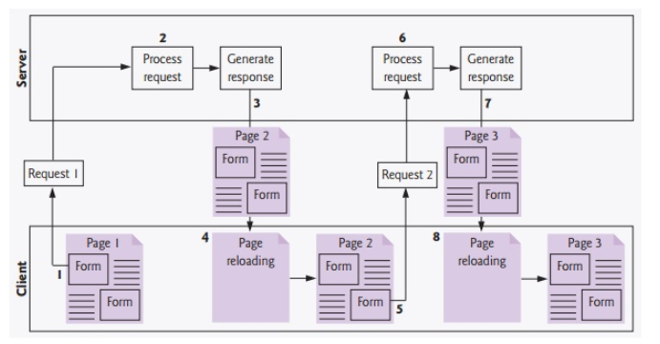
Traditional Approach
the user fills in the form’s fields, then submits the form (Fig. Step 1).
The browser generates a request to the server, which receives the request and processes it (Step 2).
The server generates and sends a response containing the exact page that the browser will render (Step 3), which causes the browser to load the new page (Step 4) and temporarily makes the browser window blank
Note that the client waits for the server to respond and reloads the entire page with the data from the response (Step4).
While such a synchronous request is being processed on the server, the user cannot interact with the client web page.
Notes:
How presentation will benefit audience: Adult learners are more interested in a subject if they know how or why it is important to them.
Presenter’s level of expertise in the subject: Briefly state your credentials in this area, or explain why participants should listen to you.

Slide 27
Traditional Approach
Frequent long periods of waiting, due perhaps to Internet congestion, have led some users to refer to the World Wide Web as the “World Wide Wait.”
If the user interacts with and submits another form, the process begins again (Steps 5–8).
Notes:
How presentation will benefit audience: Adult learners are more interested in a subject if they know how or why it is important to them.
Presenter’s level of expertise in the subject: Briefly state your credentials in this area, or explain why participants should listen to you.

Slide 28
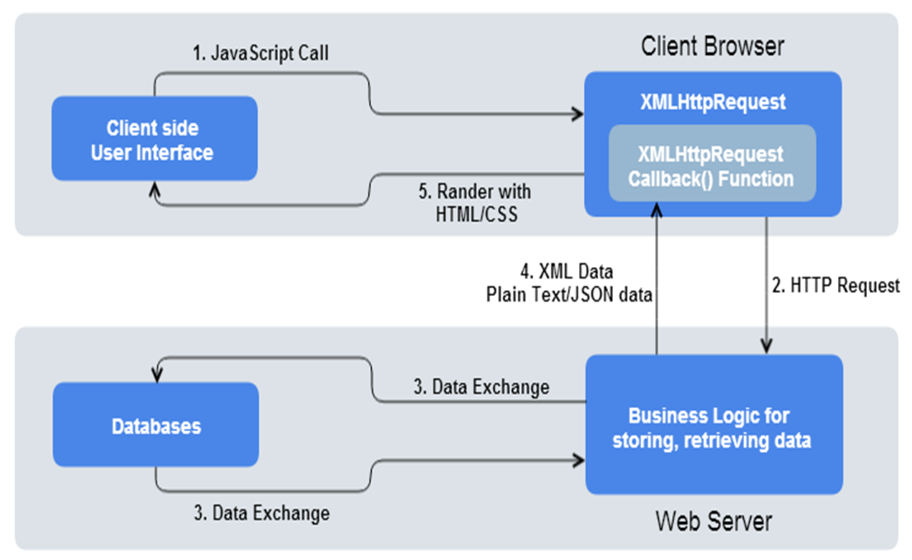
AJAX Design Basics – Working of AJAX
Notes:
How presentation will benefit audience: Adult learners are more interested in a subject if they know how or why it is important to them.
Presenter’s level of expertise in the subject: Briefly state your credentials in this area, or explain why participants should listen to you.

Slide 29
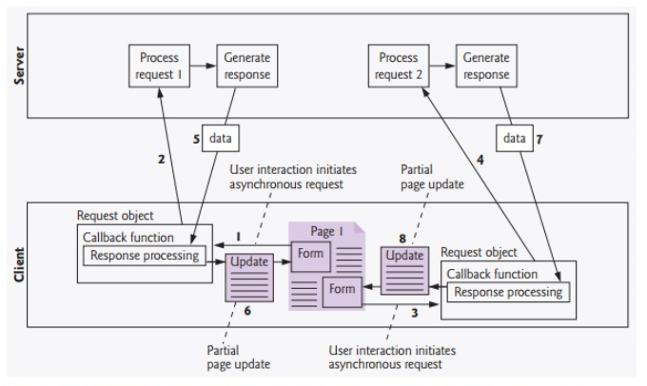
AJAX Web Application Model
Ajax applications add a layer between the client and the server to manage communication between the two
When the user interacts with the page, the client creates an XMLHttpRequest object to manage a request (Step 1).
The XMLHttpRequest object sends the request to the server (Step 2) and awaits the response.
The requests are asynchronous, so the user can continue interacting with the application on the client-side while the server processes the earlier request concurrently.
Other user interactions could result in additional requests to the server (Steps 3 and 4).
Once the server responds to the original request (Step 5), the XMLHttpRequest object that issued the request calls a client side function to process the data returned by the server.
Notes:
How presentation will benefit audience: Adult learners are more interested in a subject if they know how or why it is important to them.
Presenter’s level of expertise in the subject: Briefly state your credentials in this area, or explain why participants should listen to you.

Slide 30
AJAX Web Application Model
This function known as a callback function uses partial page updates (Step 6) to display the data in the existing web page without re-loading the entire page.
At the same time, the server may be responding to the second request (Step 7) and the client-side may be starting to do another partial page update (Step 8).
The callback function updates only a designated part of the page. Such partial page updates help make web applications more responsive, making them feel more like desktop applications.
The web application does not load a new page while the user interacts with it.
Notes:
How presentation will benefit audience: Adult learners are more interested in a subject if they know how or why it is important to them.
Presenter’s level of expertise in the subject: Briefly state your credentials in this area, or explain why participants should listen to you.

Slide 31
Key Points
AJAX or Ajax is Asynchronous JavaScript and XML.
It is used for exchanging data with a server and updating a portion of a webpage without reloading the whole webpage on the client side.
The display and behavior of the existing webpage doesn’t get interfered at all while exchanging and updating the data.
Ajax is also considered a group of technologies which has HTML, CSS, DOM, and JavaScript that are utilized to mark up, style, and allow the user to interact with the information on the webpage.
Some basic knowledge of HTML, DOM, JavaScript, and a local Web server or remote Web Server is required.
Notes:
How presentation will benefit audience: Adult learners are more interested in a subject if they know how or why it is important to them.
Presenter’s level of expertise in the subject: Briefly state your credentials in this area, or explain why participants should listen to you.

Slide 32
JQuery

Slide 33
JQuery
jQuery is open source, browser-independent, platform-independent.
The most important reason behind developing jQuery is to simplify client side scripting (i.e. coding JavaScript).
Using JavaScript, it is frustrating in some of the situations like selecting or targeting HTML elements, applying effects to them, adding and removing events, navigating and manipulating DOM tree, developing AJAX applications etc
jQuery makes things like selecting or targeting elements , adding styles, adding effects, creating animations, event handling, navigating and manipulating DOM tree, developing AJAX applications etc.
It is much much simpler than JavaScript.
Notes:
How presentation will benefit audience: Adult learners are more interested in a subject if they know how or why it is important to them.
Presenter’s level of expertise in the subject: Briefly state your credentials in this area, or explain why participants should listen to you.

Slide 34
JQuery Syntax
The jQuery syntax is tailor-made for selecting HTML elements and performing some action on the element(s).
Basic syntax is: $(selector).action()
where
$ sign to define/access jQuery
(selector) to "query (or find)" HTML elements
jQuery action() to be performed on the element(s)
Examples:
$(this).hide() - hides the current element.
$("p").hide() - hides all <p> elements.
$(".test").hide() - hides all elements with class="test".
$("#test").hide() - hides the element with id="test".
Notes:
How presentation will benefit audience: Adult learners are more interested in a subject if they know how or why it is important to them.
Presenter’s level of expertise in the subject: Briefly state your credentials in this area, or explain why participants should listen to you.

Slide 35
The Document Ready Event
Here all jQuery methods in examples, are inside a document ready event:
$(document).ready(function(){
// jQuery methods go here...
});
This is to prevent any jQuery code from running before the document is finished loading (is ready).
It is good practice to wait for the document to be fully loaded and ready before working with it.
This also allows you to have your JavaScript code before the body of your document, in the head section.
Notes:
How presentation will benefit audience: Adult learners are more interested in a subject if they know how or why it is important to them.
Presenter’s level of expertise in the subject: Briefly state your credentials in this area, or explain why participants should listen to you.

Slide 36
The Document Ready Event
Here are some examples of actions that can fail if methods are run before the document is fully loaded:
Trying to hide an element that is not created yet
Trying to get the size of an image that is not loaded yet
The jQuery team has also created an even shorter method for the document ready event:
$(function(){
// jQuery methods go here...
});
Notes:
How presentation will benefit audience: Adult learners are more interested in a subject if they know how or why it is important to them.
Presenter’s level of expertise in the subject: Briefly state your credentials in this area, or explain why participants should listen to you.

Slide 37
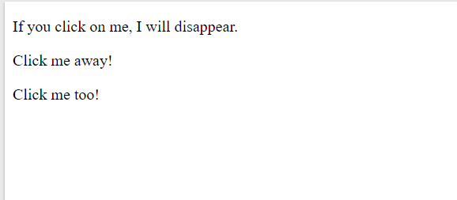
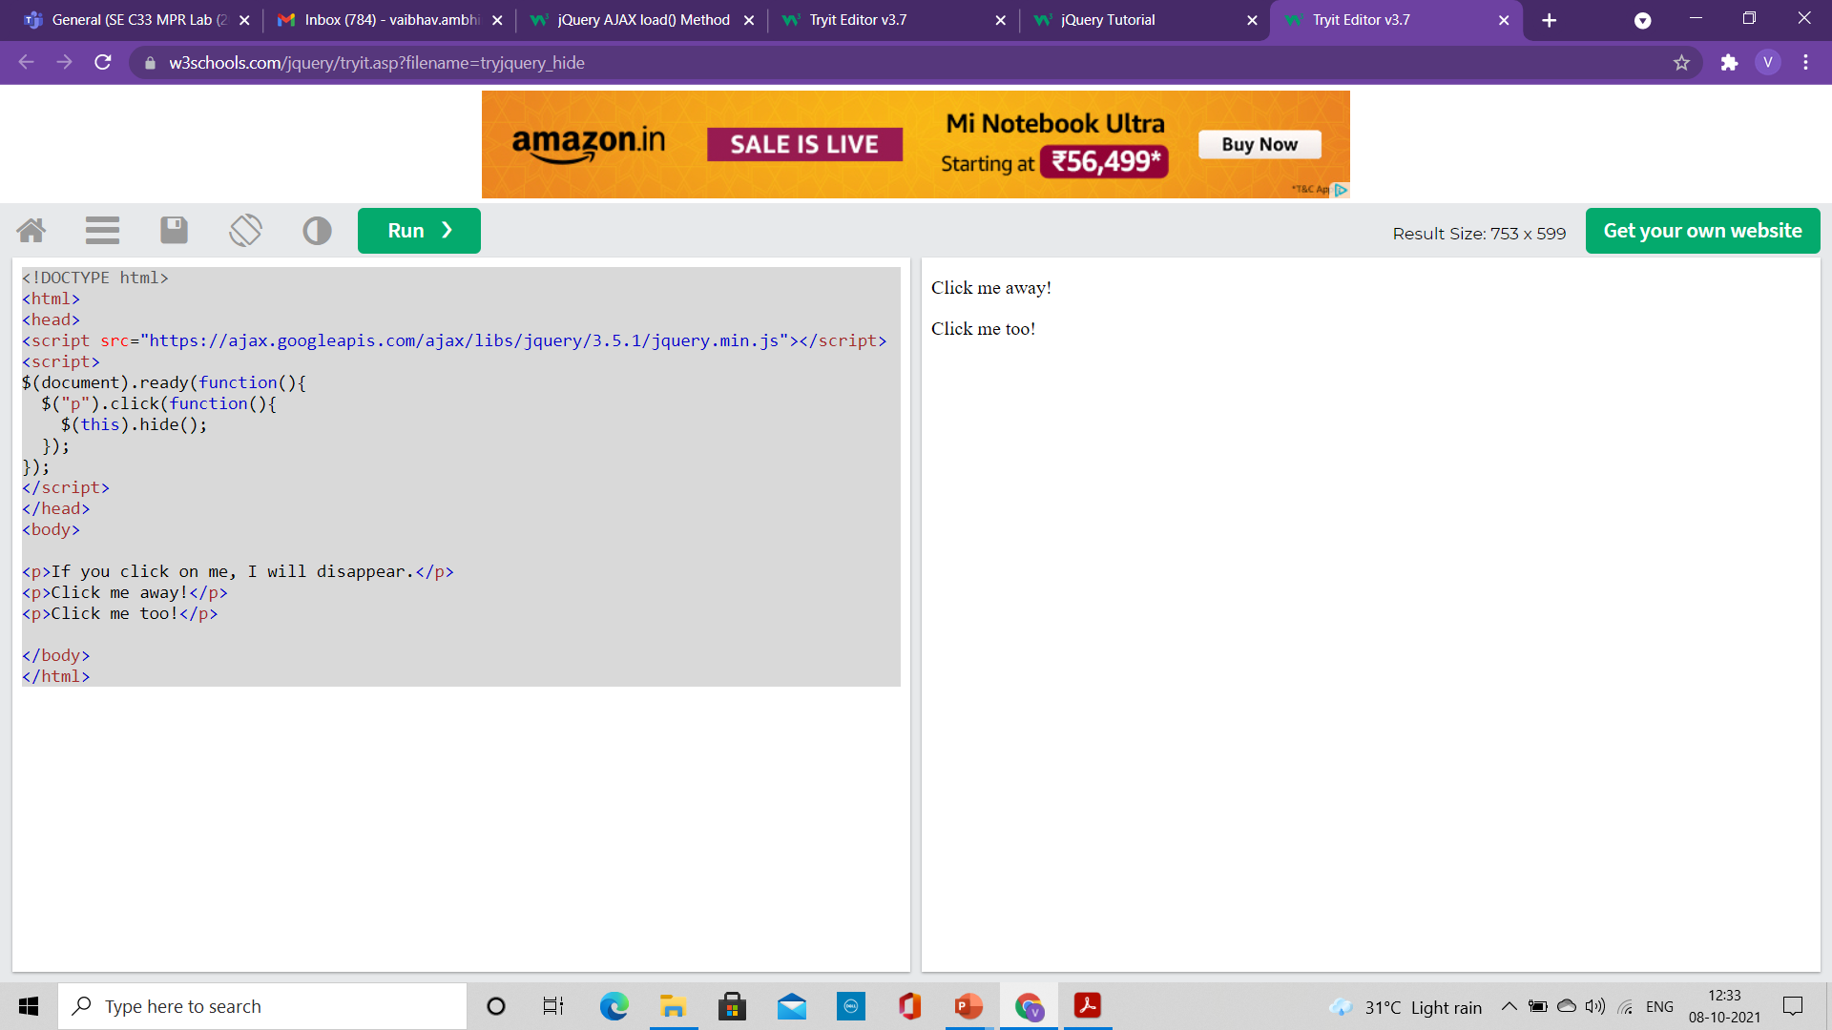
Jquery Example
<!DOCTYPE html>
<html>
<head>
<script src="https://ajax.googleapis.com/ajax/libs/jquery/3.5.1/jquery.min.js"></script>
<script>
$(document).ready(function(){
$("p").click(function(){
$(this).hide();
});
});
</script>
</head>
<body>
<p>If you click on me, I will disappear.</p>
<p>Click me away!</p>
<p>Click me too!</p>
</body>
</html>
Notes:
How presentation will benefit audience: Adult learners are more interested in a subject if they know how or why it is important to them.
Presenter’s level of expertise in the subject: Briefly state your credentials in this area, or explain why participants should listen to you.

Slide 38
JQuery and AJAX
jQuery provides several methods for AJAX functionality.
With the jQuery AJAX methods, you can request text, HTML, XML, or JSON from a remote server using both HTTP Get and HTTP Post –
And you can load the external data directly into the selected HTML elements of your web page!
Writing regular AJAX code can be a bit tricky, because different browsers have different syntax for AJAX implementation.
This means that you will have to write extra code to test for different browsers.
However, the jQuery team has taken care of this for us, so that we can write AJAX functionality with only one single line of code.
Notes:
How presentation will benefit audience: Adult learners are more interested in a subject if they know how or why it is important to them.
Presenter’s level of expertise in the subject: Briefly state your credentials in this area, or explain why participants should listen to you.

Slide 39
JQuery - AJAX load() Method
The jQuery load() method is a simple, but powerful AJAX method.
The load() method loads data from a server and puts the returned data into the selected element.
Syntax:
$(selector).load(URL, data, callback);
The required URL parameter specifies the URL you wish to load.
The optional data parameter specifies a set of querystring key/value pairs to send along with the request.
The optional callback parameter is the name of a function to be executed after the load() method is completed.
Notes:
How presentation will benefit audience: Adult learners are more interested in a subject if they know how or why it is important to them.
Presenter’s level of expertise in the subject: Briefly state your credentials in this area, or explain why participants should listen to you.

Slide 40
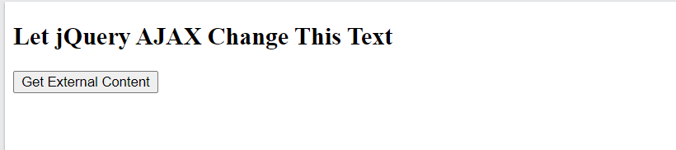
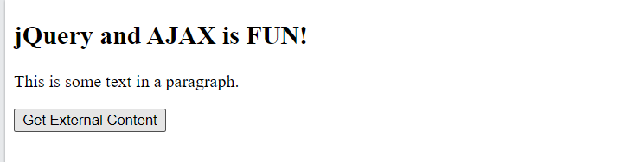
JQuery - AJAX load() Method
<!DOCTYPE html>
<html>
<head>
<script src="https://ajax.googleapis.com/ajax/libs/jquery/3.5.1/jquery.min.js"></script>
<script>
$(document).ready(function(){
$("button").click(function(){
$("#div1").load("demo_test.txt");
});
});
</script>
</head>
<body>
<div id="div1"><h2>Let jQuery AJAX Change This Text</h2></div>
<button>Get External Content</button>
</body>
</html>
The following example loads the content of the file "demo_test.txt" into a specific <div> element
Here is the content of our example file: "demo_test.txt":
<h2>jQuery and AJAX is FUN!!!</h2>
<p id="p1">This is some text in a paragraph.</p>
Notes:
How presentation will benefit audience: Adult learners are more interested in a subject if they know how or why it is important to them.
Presenter’s level of expertise in the subject: Briefly state your credentials in this area, or explain why participants should listen to you.

Slide 41
JQuery - AJAX load() Method
<!DOCTYPE html>
<html>
<head>
<script src="https://ajax.googleapis.com/ajax/libs/jquery/3.5.1/jquery.min.js"></script>
<script>
$(document).ready(function(){
$("button").click(function(){
$("#div1").load("demo_test.txt #p1");
});
});
</script>
</head>
<body>
<div id="div1"><h2>Let jQuery AJAX Change This Text</h2></div>
<button>Get External Content</button>
</body>
</html>
It is also possible to add a jQuery selector to the URL parameter.
The following example loads the content of the element with id="p1", inside the file
"demo_test.txt", into a specific <div> element
Notes:
How presentation will benefit audience: Adult learners are more interested in a subject if they know how or why it is important to them.
Presenter’s level of expertise in the subject: Briefly state your credentials in this area, or explain why participants should listen to you.

Slide 42
JQuery - AJAX get() Method
<!DOCTYPE html>
<html>
<head>
<script src="https://ajax.googleapis.com/ajax/libs/jquery/3.5.1/jquery.min.js"></script>
<script>
$(document).ready(function(){
$("button").click(function(){
$.get("demo_test.asp", function(data, status){
alert("Data: " + data + "\nStatus: " + status);
});
});
});
</script>
</head>
<body>
<button>Send an HTTP GET request to a page and get the result back</button>
</body>
</html>
jQuery $.get() Method
The $.get() method requests data from the server with an HTTP GET request.
Syntax:
$.get(URL,callback);
The required URL parameter specifies the URL you wish to request.
The optional callback parameter is the name of a function to be executed if the request succeeds.
The following example uses the $.get() method to retrieve data from a file on the server:
Notes:
How presentation will benefit audience: Adult learners are more interested in a subject if they know how or why it is important to them.
Presenter’s level of expertise in the subject: Briefly state your credentials in this area, or explain why participants should listen to you.

Slide 43
JQuery - AJAX get() Method
jQuery $.get() Method
The first parameter of $.get() is the URL we wish to request ("demo_test.asp").
The second parameter is a callback function. The first callback parameter holds the content of the page requested, and the second callback parameter holds the status of the request.
Here is how the ASP file looks like ("demo_test.asp"):
<%
response.write("This is some text from an external ASP file.")
%>
<!DOCTYPE html>
<html>
<head>
<script src="https://ajax.googleapis.com/ajax/libs/jquery/3.5.1/jquery.min.js"></script>
<script>
$(document).ready(function(){
$("button").click(function(){
$.get("demo_test.asp", function(data, status){
alert("Data: " + data + "\nStatus: " + status);
});
});
});
</script>
</head>
<body>
<button>Send an HTTP GET request to a page and get the result back</button>
</body>
</html>
Notes:
How presentation will benefit audience: Adult learners are more interested in a subject if they know how or why it is important to them.
Presenter’s level of expertise in the subject: Briefly state your credentials in this area, or explain why participants should listen to you.

Slide 44
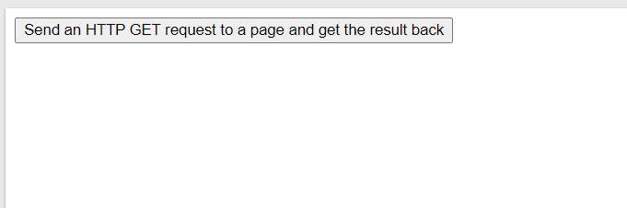
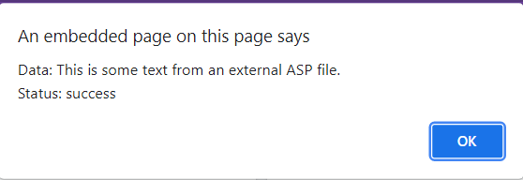
JQuery - AJAX get() Method
<!DOCTYPE html>
<html>
<head>
<script src="https://ajax.googleapis.com/ajax/libs/jquery/3.5.1/jquery.min.js"></script>
<script>
$(document).ready(function(){
$("button").click(function(){
$.get("demo_test.asp", function(data, status){
alert("Data: " + data + "\nStatus: " + status);
});
});
});
</script>
</head>
<body>
<button>Send an HTTP GET request to a page and get the result back</button>
</body>
</html>
Notes:
How presentation will benefit audience: Adult learners are more interested in a subject if they know how or why it is important to them.
Presenter’s level of expertise in the subject: Briefly state your credentials in this area, or explain why participants should listen to you.

Slide 45
JQuery – AJAX post() Method
<!DOCTYPE html>
<html>
<head>
<script src="https://ajax.googleapis.com/ajax/libs/jquery/3.5.1/jquery.min.js"></script>
<script>
$(document).ready(function(){
$("button").click(function(){
$.post("demo_test_post.asp",
{
name: "Donald Duck",
city: "Duckburg"
},
function(data,status){
alert("Data: " + data + "\nStatus: " + status);
});
});
});
</script>
</head>
<body>
<button>Send an HTTP POST request to a page and get the result back</button>
</body>
</html>
jQuery $.post() Method
The $.post() method requests data from the server using an HTTP POST request.
Syntax:
$.post(URL,data,callback);
The required URL parameter specifies the URL you wish to request.
The optional data parameter specifies some data to send along with the request.
The optional callback parameter is the name of a function to be executed if the request succeeds.
The following example uses the $.post() method to send some data along with the request
Notes:
How presentation will benefit audience: Adult learners are more interested in a subject if they know how or why it is important to them.
Presenter’s level of expertise in the subject: Briefly state your credentials in this area, or explain why participants should listen to you.

Slide 46
JQuery – AJAX post() Method
<!DOCTYPE html>
<html>
<head>
<script src="https://ajax.googleapis.com/ajax/libs/jquery/3.5.1/jquery.min.js"></script>
<script>
$(document).ready(function(){
$("button").click(function(){
$.post("demo_test_post.asp",
{
name: "Donald Duck",
city: "Duckburg"
},
function(data,status){
alert("Data: " + data + "\nStatus: " + status);
});
});
});
</script>
</head>
<body>
<button>Send an HTTP POST request to a page and get the result back</button>
</body>
</html>
jQuery $.post() Method
The first parameter of $.post() is the URL we wish to request ("demo_test_post.asp").
Then we pass in some data to send along with the request (name and city).
The ASP script in "demo_test_post.asp" reads the parameters, processes them, and returns a result.
The third parameter is a callback function.
The first callback parameter holds the content of the page requested, and the second callback parameter holds the status of the request.
Notes:
How presentation will benefit audience: Adult learners are more interested in a subject if they know how or why it is important to them.
Presenter’s level of expertise in the subject: Briefly state your credentials in this area, or explain why participants should listen to you.

Slide 47
JQuery – AJAX post() Method
<!DOCTYPE html>
<html>
<head>
<script src="https://ajax.googleapis.com/ajax/libs/jquery/3.5.1/jquery.min.js"></script>
<script>
$(document).ready(function(){
$("button").click(function(){
$.post("demo_test_post.asp",
{
name: "Donald Duck",
city: "Duckburg"
},
function(data,status){
alert("Data: " + data + "\nStatus: " + status);
});
});
});
</script>
</head>
<body>
<button>Send an HTTP POST request to a page and get the result back</button>
</body>
</html>
jQuery $.post() Method
Here is how the ASP file looks like ("demo_test_post.asp"):
<%
dim fname,city
fname=Request.Form("name")
city=Request.Form("city")
Response.Write("Dear " & fname & ". ")
Response.Write("Hope you live well in " & city & ".")
%>
Notes:
How presentation will benefit audience: Adult learners are more interested in a subject if they know how or why it is important to them.
Presenter’s level of expertise in the subject: Briefly state your credentials in this area, or explain why participants should listen to you.

Slide 48
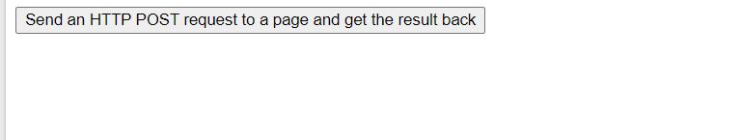
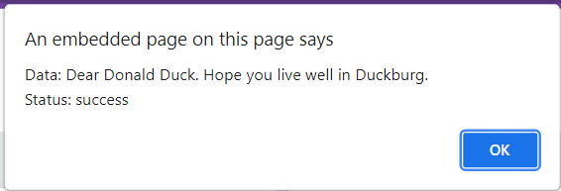
JQuery – AJAX post() Method
<!DOCTYPE html>
<html>
<head>
<script src="https://ajax.googleapis.com/ajax/libs/jquery/3.5.1/jquery.min.js"></script>
<script>
$(document).ready(function(){
$("button").click(function(){
$.post("demo_test_post.asp",
{
name: "Donald Duck",
city: "Duckburg"
},
function(data,status){
alert("Data: " + data + "\nStatus: " + status);
});
});
});
</script>
</head>
<body>
<button>Send an HTTP POST request to a page and get the result back</button>
</body>
</html>
Notes:
How presentation will benefit audience: Adult learners are more interested in a subject if they know how or why it is important to them.
Presenter’s level of expertise in the subject: Briefly state your credentials in this area, or explain why participants should listen to you.

Slide 50
Lesson 1: Content
Add text here.
To add a picture, chart, or other content in the right column, click the appropriate icon.
To add a slide, click New Slide on the Insert menu, or press CTRL+M.

Slide 51
Lesson 1: Wrap-up
Summarize important points.
Allow time for questions.

Slide 52
Lesson 2: Objectives
List the intended outcomes for this training session.
Each objective should be concise, should contain a verb, and should have a measurable result.

Slide 53
Lesson 2: Content
Add text here.
To add a picture, chart, or other content in the right column, click the appropriate icon.
To add a slide, click New Slide on the Insert menu, or press CTRL+M.

Slide 54
Lesson 2: Wrap-up
Summarize important points.
Allow time for questions.

Slide 55
Lesson 3: Objectives
List the intended outcomes for this training session.
Each objective should be concise, should contain a verb, and should have a measurable result.

Slide 56
Lesson 3: Content
Add text here.
To add a picture, chart, or other content in the right column, click the appropriate icon.
To add a slide, click New Slide on the Insert menu, or press CTRL+M.

Slide 57
Lesson 3: Wrap-up
Summarize important points.
Allow time for questions.

Slide 58
Summary of Training
List important points from each lesson.
Provide resources for more information on subject.
List resources on this slide.
Provide handouts with additional resource material.

Slide 59
Assessment and Evaluation
Prepare a quiz or challenge to assess how much information participants learned.
Survey participants to see if they found the training beneficial.

